Slide 1
Y11 Apps Chapter 5 Situation 7
Pete and Julie want to go on holiday with their two children next year, but are not sure they will be able to save enough money to pay for it. They decide to prepare a budget.
This means that they allocate their future income to the various expenses they are likely to occur, to see if there is enough income left over to create a holiday fund.
They know that the total family income is $1330 per week and they have the following weekly expenses.
Rent $320 Utilities $30 Phones $20
Internet $15 Entertainment/meals out $100 Clothing $75
Car $160 Health fund $80 Insurances $40
Loan repayments $95 Food $200 Sports and Gym $50

Slide 2
Y11 Apps Chapter 5 Situation 6
They know that the total family income is $1330 per week and they have the following weekly expenses.
Rent $320 Utilities $30 Phones $20
Internet $15 Entertainment/meals out $100 Clothing $75
Car $160 Health fund $80 Insurances $40
Loan repayments $95 Food $200 Sports and Gym $50
Some of these involve fixed expenditure (fixed, agreed amount per week – probably paid fortnightly or monthly).
Some of these involve discretionary spending (the family can choose to spend more or less each week).

Slide 3
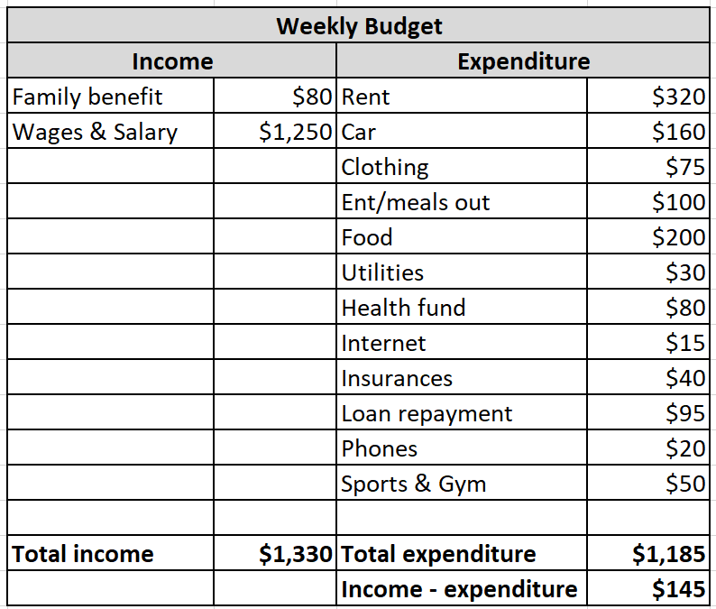
Y11 Apps Chapter 5 Situation 6
Now do worksheet – budgeting scenarios or Mathspace
The budget shown below shows that they could start a holiday fund with $145 per week being available to go into it, providing they stick to their budget.

